Slide 1
The Collaborative on Academic Careers in Higher Education (COACHE) Survey Review
Faculty Recruiting and Retention Council (FRRC)

Slide 2
From FUMFRR to FRRC
2006
Task Force for Female & Underrepresented Minority Faculty Recruitment and Retention (FUMFRR)
2015
Faculty Recruiting and Retention Council (FRRC)
Accomplishments
On Going Initiatives
Family Leave Policies (FMLA) provides extension of the tenure clock
Women Faculty Survey
Child Development Center Needs Assessment
Rolla-St. Louis Shuttle Needs Assessment
Establishment of Faculty Center
Pursuit of a Child Development Center for S&T faculty and staff
NSF ADVANCE grant
Improve campus climate initiatives
Host New Faculty welcome events
Develop best practices & strategies for the recruitment & retention of female & minority faculty
Faculty salary equity issues
Dual Career Hiring Policy

Slide 3
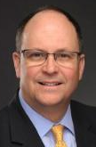
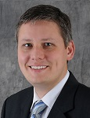
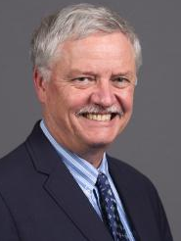
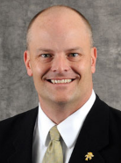
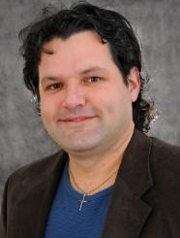
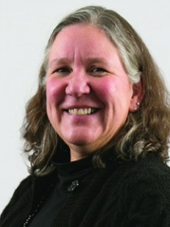
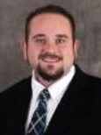

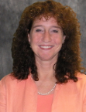
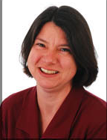
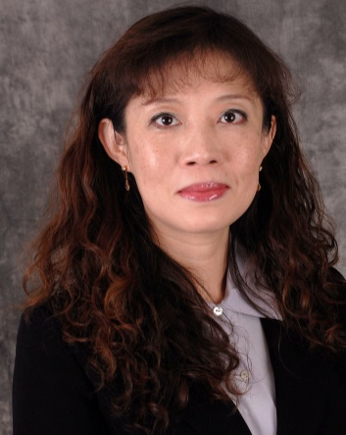
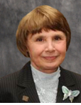
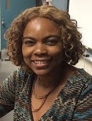
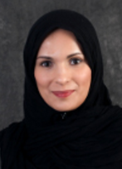
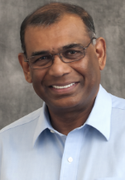
FRRC Members
Provost Robert Marley | Dr. Douglas Bristow | Dr. Richard Brow | Dr. Joel Burken | Dr. Carlos Castano | Dr. Mariesa Crow | Dr. Garry Grubbs | Dr. Irina Ivliyeva
 | Prof. Merilee Krueger | Dr. Melanie Mormile | Dr. Bih-Ru Lea | Dr. Frances Montgomery | Dr. Francisca Oboh-Ikuenobe | Dr. Sahra Sedigh Sarvestani | Dr. V.A. Samaranayake

Slide 4
COACHE Survey
Faculty Recruitment & Retention Committee (FRRC)

Slide 5
What is COACHE?
The Collaborative on Academic Careers in Higher Education (COACHE) is a Harvard-based consortium of institutional leaders who are taking cost-effective steps to improve outcomes in faculty recruitment, development, and retention.

Slide 6
Results Previously from COACHE
Previous study performed in 2008
Targeted to pre-tenured faculty
Major concern at time was unclear guidance on the Promotion and Tenure expectations
Successfully overcame this concern

Slide 7
The Current COACHE Survey
Survey taken in Spring 2016
ALL faculty invited to participate
Results sent to Provost in August 2016
COACHE webinar held with Provost on August 25, 2016
COACHE representative, Todd Benson, teleconferenced with FRRC on September 14, 2016
Provides a snapshot of campus during the Spring semester

Slide 8
Response Rates of Comparators

Slide 9
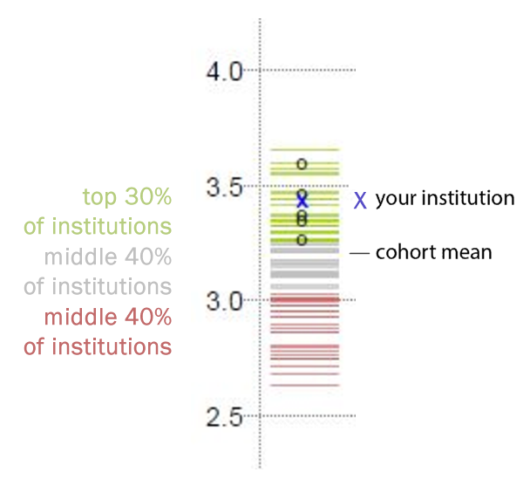
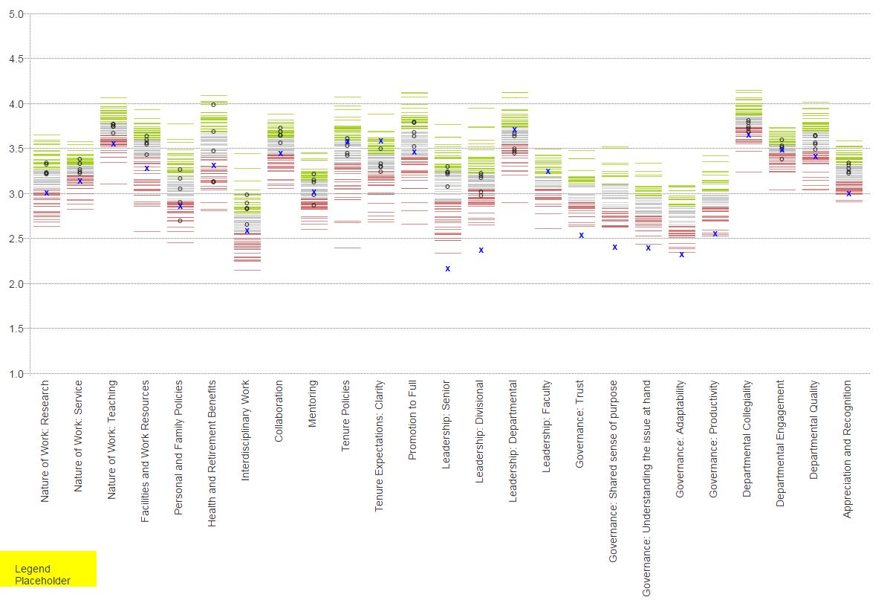
Benchmark Analysis

Slide 10
Benchmark Analysis

Slide 11
Benchmark Analysis
S&T outperformed the selected peer group in
Tenure Policies
Tenure Expectations Clarity
Leadership: Departmental

Slide 12
Benchmark Analysis
S&T performed similar to the selected peer group in
Mentoring
Departmental Engagement

Slide 13
Benchmark Analysis
S&T performed below the selected peer group in
Nature of Work in Research, Service, & Teaching
Facility & Work: Research
Interdisciplinary Work
Collaboration
Promotion to full
Leadership: Senior
Leadership: Divisional
Departmental Quality
Appreciation & Recognition

Slide 14
Benchmark Analysis
New Governance dimension
Leadership: Faculty
Governance: Trust
Governance: Shared sense of purpose
Governance: Understanding Issue at hand
Governance: Adaptability
Governance: Productivity
(note all participating institutions are used in this group as statistics are not available for the selected peer group and)

Slide 15
Benchmark Analysis
S&T performed below all 89 universities in
Leadership: Senior
Leadership: Divisional
Governance: Trust
Governance: Shared sense of purpose
Governance: Understanding the issue at hand
Governance: Adaptability

Slide 16
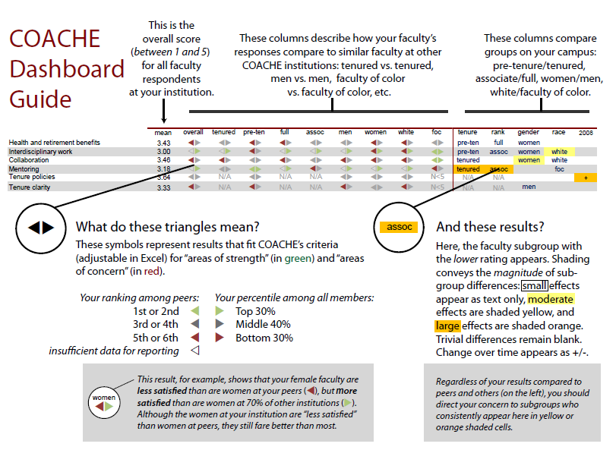

Slide 17
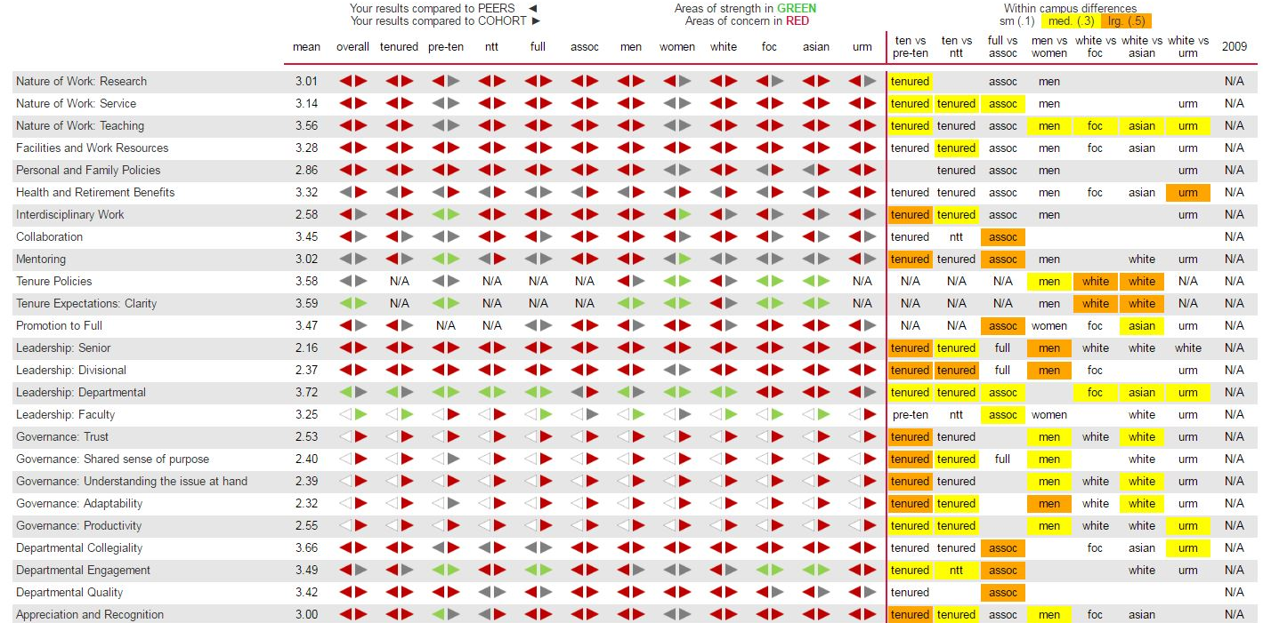
Benchmarks Dashboard

Slide 18
Benchmarks Dashboard
Green: Area of strength
Red: Areas of concern

Slide 19
Thematic Breakouts
Please refer to the web site
One example is shown below

Slide 20
Benchmarks Dashboard

Slide 21
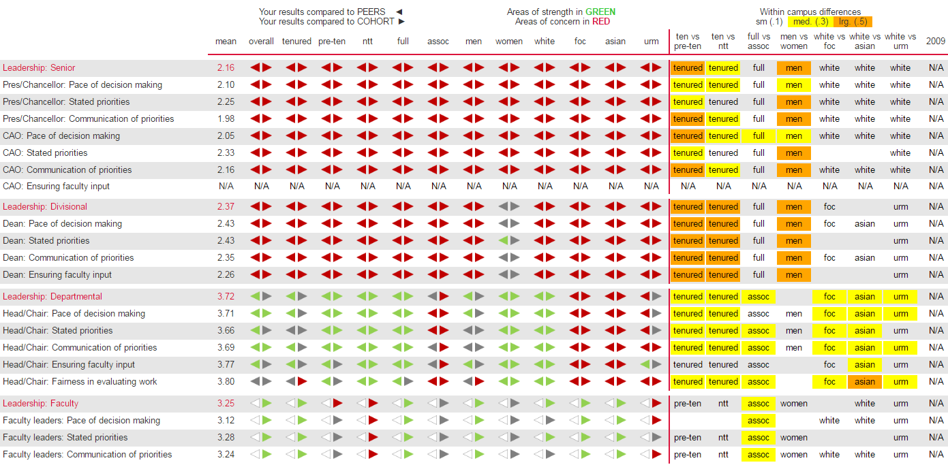
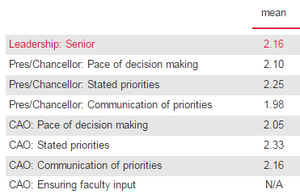

Slide 22
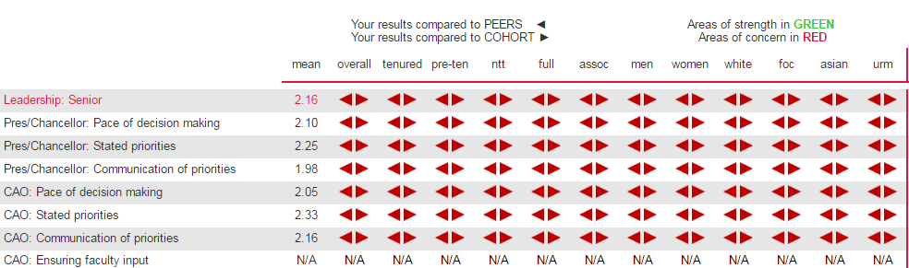

Example: Leadership Breakdown
Green: Area of strength
Red: Areas of concern

Slide 23
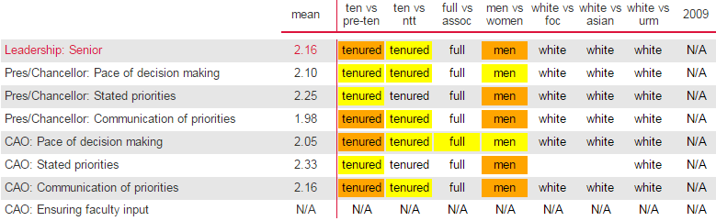
Example: Leadership Breakdown
Green: Area of strength
Red: Areas of concern
Within campus differences
Sm(.1)
med(.3)
lrg(.5)

Slide 24
Divisional Analysis
X College of Engineering & Computing
O College of Arts, Science, & Business

Slide 25
Overall: Best Aspects
Faculty were asked to identify the TWO (and only TWO) best aspects of working at an institute.
The top four responses for an institute are shown in red and disaggregated by tenure status, rank, gender and race.

Slide 26
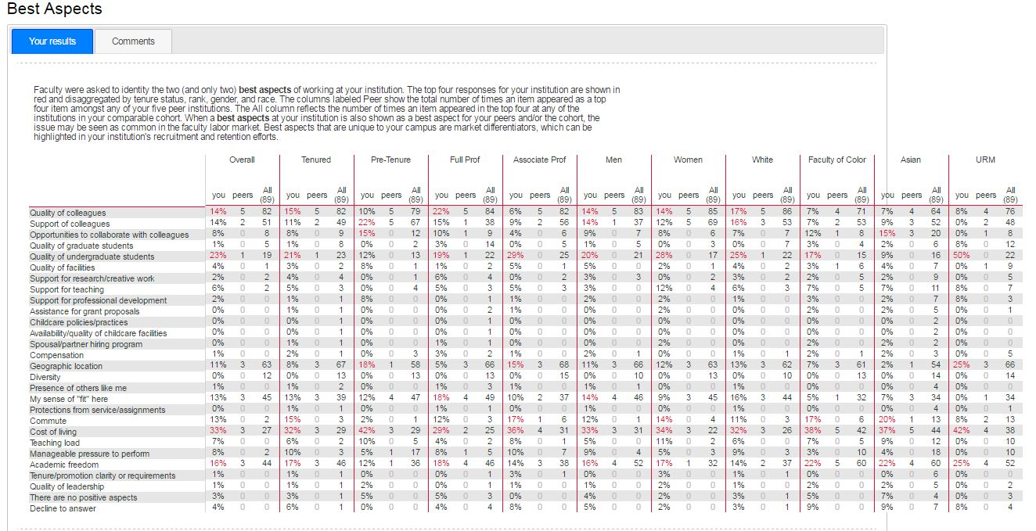
Overall: Best Aspects
Quality of Colleagues
Quality of undergraduate students
Cost of Living
Academic Freedom

Slide 27
Overall: Worst Aspects
Faculty were asked to identify the TWO (and only TWO) worst aspects of working at an institute.
The top four responses for an institute are shown in red and disaggregated by tenure status, rank, gender and race.

Slide 28
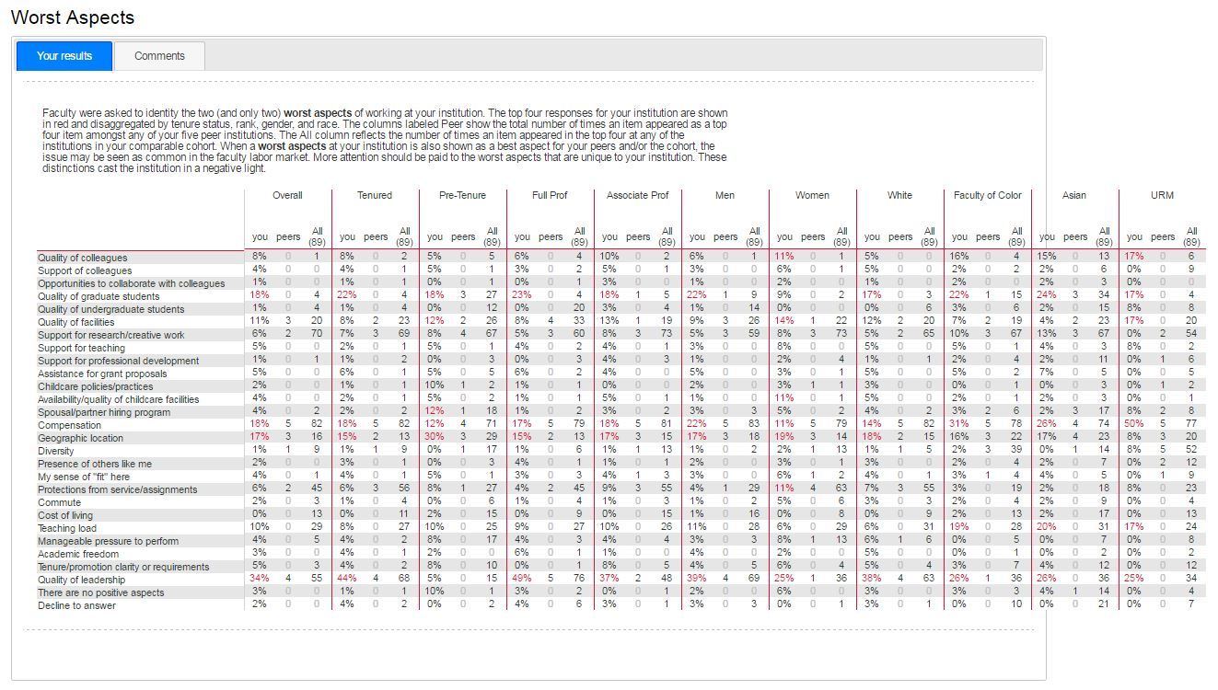
Overall: Worst Aspects
Quality of graduate students
Compensation
Geographic location
Quality of leadership

Slide 29
One Improvement Area
COACHE asks faculty to describe the one thing an institute can do to improve the workplace for faculty
COACHE analysts assigned all responses to one or more common theme
Quality of graduate students
Compensation
Geographic location
Quality of leadership

Slide 30
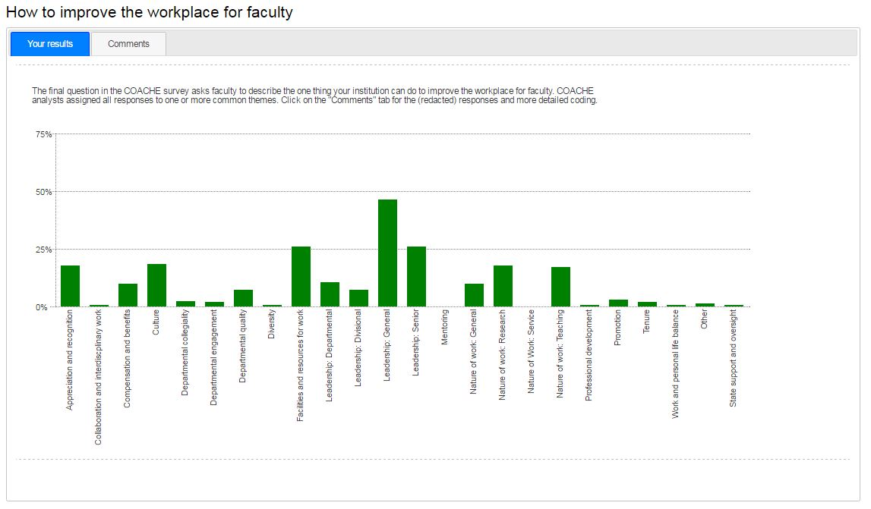
One Improvement Area
Leadership: General
Quality of graduate students
Compensation
Geographic location
Quality of leadership

Slide 31
Overview: Areas of Strength
Clarity of Tenure Expectations
Tenure Policies
Faculty Leadership

Slide 32
Overview: on par with Comparators
Areas where we are on par with our comparators
  Mentoring
  Department Engagement

Slide 33
Overview: Areas of Concern
  Nature of Work (Research, Service, and Teaching)
  Facilities and work resources
  Interdisciplinary work
  Collaboration
  Promotion to Full Professor
  Senior & Divisional Leadership
  Governance (Trust, Shared sense of purpose, Understanding the issue at hand, Adaptability, Productivity)
  Departmental Collegiality
  Departmental Quality
  Appreciation & Recognition

Slide 34
Where to Go from Here?
Much data to take in – see website at
  provost.mst.edu/coachesurvey/
Another COACHE survey will be done in three years
COACHE has identified other institutions with similar concerns that have overcome them
  Opportunities to engage with them
  Ex. Virginia Tech addressed concerns about promotion to Full Professor
Concerns have been addressed previously – can do so again but will take time

