Slide 1
The Collaborative on Academic Careers in Higher Education (COACHE) 2020 Survey Review
Faculty Recruiting and Retention Council (FRRC)
Notes:
Welcome to the COACHE 2020 survey review meeting hosted by the Faculty Recruiting and Retention Council (FRRC)

Slide 2
FRRC Mission
To provide advice and counsel to campus leadership on strategies related to faculty diversity and improvement of campus climate.
Notes:
The FRRC mission
1st click: Read the slide

Slide 3
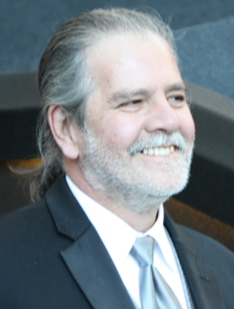
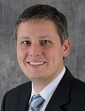
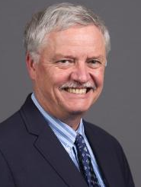
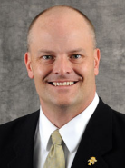
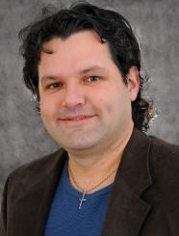
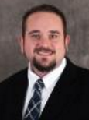
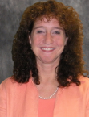
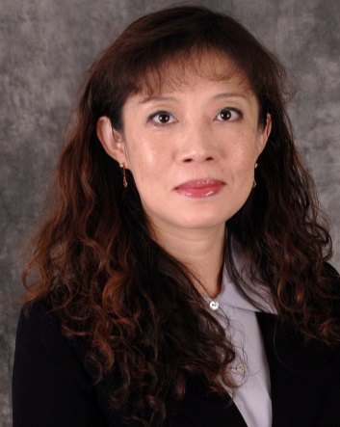
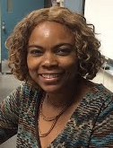
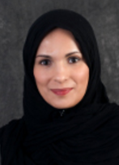
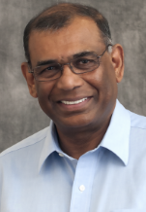
FRRC Members
Provost Steve Roberts | Dr. Daniel Forciniti (Provost Office) | Dr. Douglas Bristow | Dr. Richard Brow | Dr. Joel Burken | Dr. Carlos Castano | Dr. Garry Grubbs
 | Dr. Irina Ivliyeva | Ms. Merilee Krueger | Dr. Bih-Ru Lea | Dr. Francisca Oboh-Ikuenobe | Dr. Sahra Sedigh Sarvestani | Dr. V.A. Samaranayake
Notes:
The FRRC is chaired by Provost Roberts and currently has 12 members

Slide 4
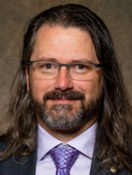
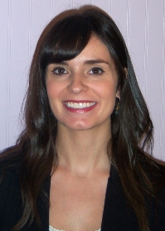
COACHE Committee
 | Dr. Daniel Forciniti (Provost Office) | Dr. Wayne Jones (Provost Office) | Dr. Stephen Raper (Faculty Senate) | Dr. Shannon Fogg (CASB) | Ms. Kelly Tate (NTT)
 | Dr. Joel Burken (Chair, FRRC) | Dr. Bih-Ru Lea (FRRC) | Dr. Francisca Oboh-Ikuenobe (CEC, FRRC) | Dr. Sahra Sedigh Sarvestani (FRRC) | Dr. V.A. Samaranayake (Chair, FRRC)
Notes:
The COACHE Committee includes representatives from the Office of Provost, Faculty Senate, two Colleges, and FRRC members.

Slide 5
2020 COACHE Survey
Faculty Recruitment & Retention Committee (FRRC)
Note:
The slide set is better to view in the presentation mode.
Please refer to speaker notes for initial data interpretation

Slide 6
What is COACHE?
The Collaborative on Academic Careers in Higher Education (COACHE) is a Harvard-based consortium of institutional leaders who are taking cost-effective steps to improve outcomes in faculty recruitment, development, and retention.
Notes:
Read the slide …

Slide 7
Previous COACHE Assessments
Previous studies performed in 2008 and 2016
Targeted groups
2008: pre-tenured faculty
2016: all faculty
https://provost.mst.edu/coachesurvey/
Notes:
Read the slide

Slide 8
The 2020 COACHE Survey Timeline
Survey taken in Spring 2020
ALL faculty invited to participate
Results sent to the Provost’s office in July 2020
COACHE Committee formed in July, ,2020
First COACHE Open Forum on September 23, 2020
Planned Action:
Collect inputs and ideas from today’s COACHE open forum
COACHE Focus Committees report findings and action items in November, 2020
Notes:
The 2020 COACHE survey timeline
1st click: the survey was deployed in spring 2020 semester and all faculty are invited to participate
2nd: Results were sent to the Provost's office in July
3rd click: COACHE Committee was formed in July to review and analyze data for actions
4th click: The COACHE committee is to report initial finding and action items on the first COACHE open forum which is today.
5th click: the goal for today is to present the COACHE Committee’s initial findings and collect inputs and ideas from those of you who are here today, so we can determine the action items to improve the faculty retention and campus climate.

Slide 9
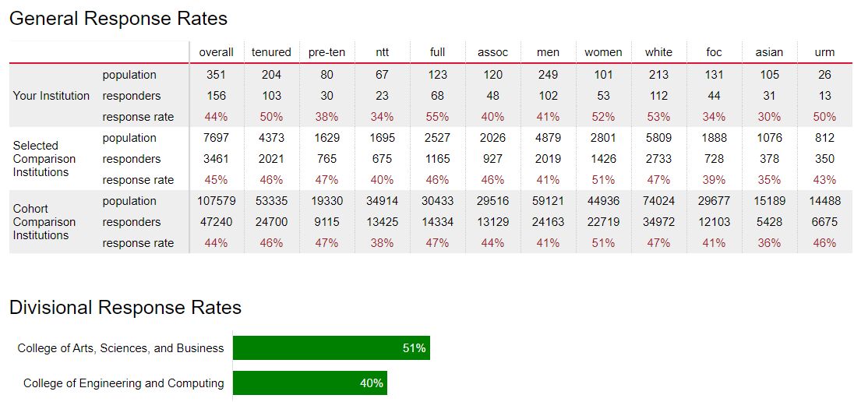
Response Rates of Comparators
Significant lower response rate in 2020
2016
Cohort: 110 similar universities identified by COACHE
Peer/Comparison Institutes:
Notes:
1st click: Our peer/comparison institutes include Clemson University, Iowa State University, North Carolina State University, Oklahoma State University, and Virginia Polytech Institute and State University.
2nd click: our cohort includes 110 similar universities identified by COACHE.
3rd click: our overall 2020 response rate is about 44%. The response rate breakdown by groups are shown on the screen.
4th click: compare to the 2016 response rate
5th click: we have a lower response rate this time.

Slide 10
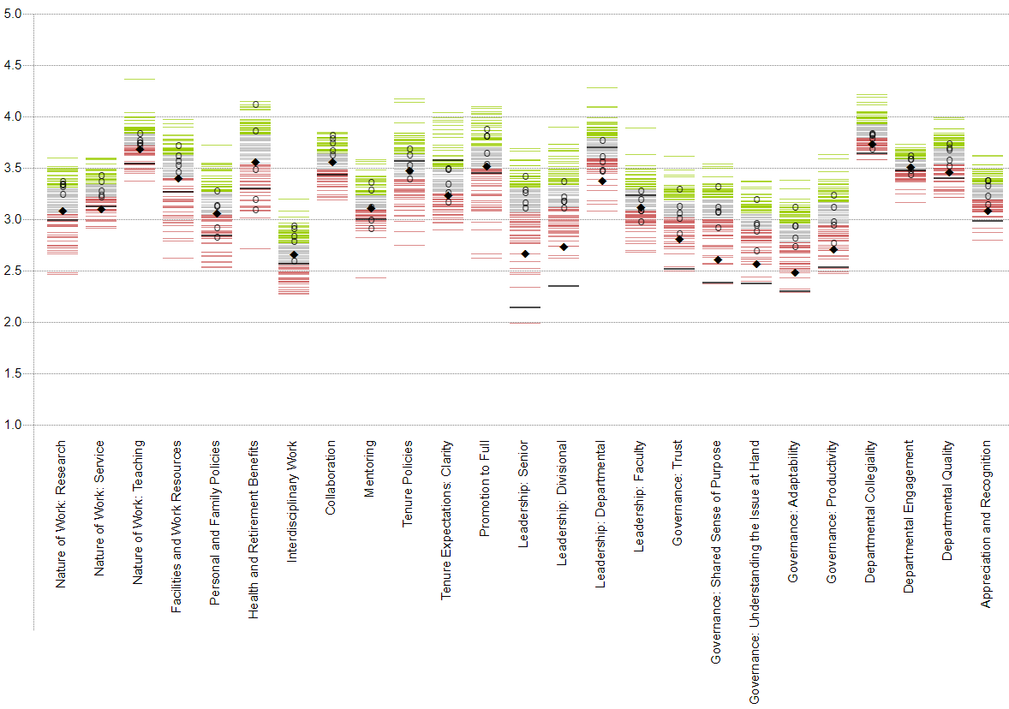
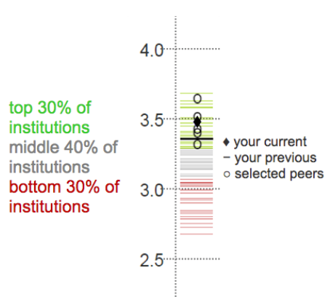
Benchmark Analysis
Leadership:
Governance:
Peer Institutes (same as 2016):
110 universities in the group
Teaching
Senior
Faculty
Trust
Research
Service
Mentoring
Divisional
Adaptability
Collaboration
Departmental
Productivity
Tenure Policies
Dept. Collegiality
Dept. Quality
Facilities & Work Resources
Promotion to Full
Dept. Engagement
Interdisciplinary Work
Tenure Expectations: Clarity
Appreciation &Recognition
Personal & Family Policies
Shared Sense of Purpose
Health & Retirement Benefits
Understanding the Issue at Hand
Notes:
The 2020 COACHE benchmark dashboard is shown here.
1st click: in the benchmark
2nd click: a black diamond shape shows our current standing
3rd click: a black line represents our last COACHE standing for comparison purpose.
4th click: our 5 peer institutes are represented by the white circles.
5th click: the 110 cohort universities are represented by different color lines.
6th click: Green lines represent top 30%,
7th click: dark gray lines represent middle 40%,
8th click: and red lines represents the bottom 30% of 100 cohort universities.

Slide 11
Leadership:
Governance:
Cross-Silo Work & Mentorship
Nature of Work
Resource & Support
P&T
Leadership
Governance
Department
Teaching
Senior
Faculty
Trust
Research
Service
Mentoring
Divisional
Adaptability
Collaboration
Departmental
Productivity
Tenure Policies
Dept. Collegiality
Dept. Quality
Facilities & Work Resources
Promotion to Full
Dept. Engagement
Interdisciplinary Work
Tenure Expectations: Clarity
Appreciation &Recognition
Personal & Family Policies
Shared Sense of Purpose
Health & Retirement Benefits
Understanding the Issue at Hand
Notes:
The overall results are grouped into 8 categories: (1st click) nature of work, (2nd click) Resource and support, (3rd click) Cross-silo work & mentorship, …

Slide 12
Cross-Silo Work & Mentorship
Nature of Work
Resource & Support
P&T
Leadership
Governance
Department
Teaching
Senior
Faculty
Trust
Research
Service
Mentoring
Divisional
Adaptability
Collaboration
Tenure Policies
Departmental
Productivity
Dept. Quality
Promotion to Full
Dept. Collegiality
Facilities & Work Resources
Tenure Expectations: Clarity
Dept. Engagement
Interdisciplinary Work
Appreciation &Recognition
Personal & Family Policies
Shared Sense of Purpose
Health & Retirement Benefits
Understanding the Issue at Hand
Notes:
We are going to present key observations from the 2020 COACH results

Slide 13
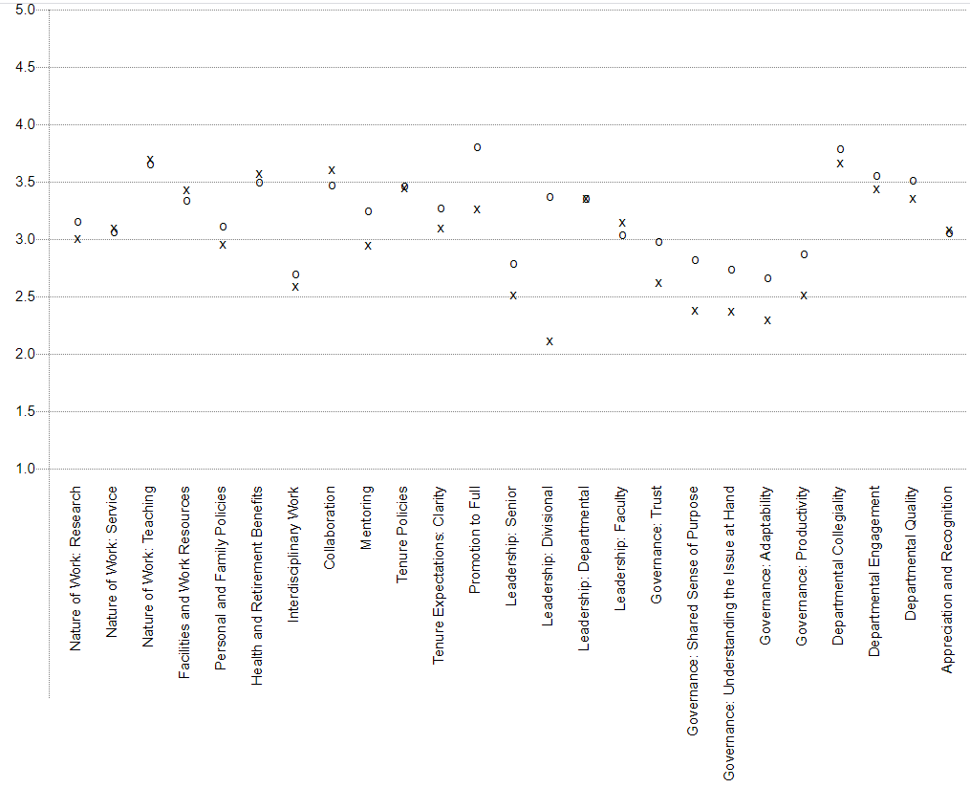
X College of Engineering & Computing
O College of Arts, Science, & Business
x
x
x
Cross-Silo Work & Mentorship
Nature of Work
Resource & Support
P&T
Leadership
Governance
Department
Research
Service
Senior
Faculty
Trust
Teaching
Mentoring
Divisional
Adaptability
Collaboration
Tenure Policies
Departmental
Productivity
Dept. Quality
Dept. Collegiality
Facilities & Work Resources
Promotion to Full
Dept. Engagement
Interdisciplinary Work
Tenure Expectations: Clarity
Appreciation &Recognition
Personal & Family Policies
Shared Sense of Purpose
Health & Retirement Benefits
Understanding the Issue at Hand
Notes:
1st click: At the college level, CEC participants are more satisfied than CASB participants in facilities and work resources, collaboration, and faculty leadership.
2nd click: CASB participants are more satisfied than CEC participants in areas marked in green including research, personal & family policies, interdisciplinary work, mentoring, clarity of tenure expectation, promotion to full professor rank, senior and divisional leadership, all dimensions of governance and department factor.

Slide 14
Areas S&T outperformed the selected peer group
2020: None
2016
Tenure Policies
Tenure Expectations Clarity
Leadership: Departmental
Cross-Silo Work & Mentorship
Nature of Work
Resource & Support
P&T
Leadership
Governance
Department
Teaching
Senior
Faculty
Trust
Research
Service
Mentoring
Divisional
Adaptability
Collaboration
Tenure Policies
Departmental
Productivity
Dept. Quality
Promotion to Full
Dept. Collegiality
Facilities & Work Resources
Tenure Expectations: Clarity
Dept. Engagement
Interdisciplinary Work
Appreciation &Recognition
Personal & Family Policies
Shared Sense of Purpose
Health & Retirement Benefits
Understanding the Issue at Hand
Notes:
1st click: The areas that S&T outperformed the selected peer group
2nd click: there is none in 20202
3rd click: In 2016, S&T outperformed our 5 peers in Tenure policies, tenure expectations clarity, and departmental leadership.
4th click: All three ratings decreased in 2020.

Slide 15
Areas S&T performed on par with the selected peer group
2020:
Personal & Family Policies
Health & Retirement Benefit
Mentoring
Leadership: Faculty
Leadership:
2016
Mentoring
Departmental Engagement
Governance:
Cross-Silo Work & Mentorship
Nature of Work
Resource & Support
P&T
Leadership
Governance
Department
Teaching
Senior
Faculty
Trust
Research
Service
Mentoring
Divisional
Adaptability
Collaboration
Departmental
Productivity
Tenure Policies
Dept. Collegiality
Dept. Quality
Facilities & Work Resources
Promotion to Full
Dept. Engagement
Interdisciplinary Work
Tenure Expectations: Clarity
Appreciation &Recognition
Personal & Family Policies
Shared Sense of Purpose
Health & Retirement Benefits
Understanding the Issue at Hand
Notes:
1st click: Areas S&T performed on par with the selected peer group
2nd click: in 2020 include
3rd click: personal and family policies
4th click: health and retirement benefit
5th click: mentoring
6th click: faculty leadership
7th click: it is an improvement compare to 2016 when we are on par in two areas: mentoring and departmental engagement
8th click: mentoring is in both 2016 and 2020
9th: Overall, we improved in three areas shown here since 2016
10th click, but faculty leadership seems to move in the negative direction since 2016.

Slide 16
Areas S&T performed below the selected peer group
Cross-Silo Work & Mentorship
Nature of Work
Resource & Support
P&T
Leadership
Governance
Department
Teaching
Senior
Faculty
Trust
Research
Service
Mentoring
Divisional
Adaptability
Collaboration
Tenure Policies
Departmental
Productivity
Dept. Quality
Promotion to Full
Dept. Collegiality
Facilities & Work Resources
Tenure Expectations: Clarity
Dept. Engagement
Interdisciplinary Work
Appreciation &Recognition
Personal & Family Policies
Shared Sense of Purpose
Health & Retirement Benefits
Understanding the Issue at Hand
Notes:
Areas S&T performed below the selected peer group
1st click: In 2020, the 15 areas we ranked at the bottom of our 5 peer institutes are marked on the screen.
2nd click: we have 4 areas that we ranked near the bottom of our 5 peer institutes
3rd click: However, our performance improved in 15 out of those 19 areas since 2016
4th click: our performance seems to move on the negative direction in 3 of those 19 areas since 2016.

Slide 17
Areas S&T performed below the selected peer group
Noticeable Improvement
Cross-Silo Work & Mentorship
Nature of Work
Resource & Support
P&T
Leadership
Governance
Department
Teaching
Senior
Faculty
Trust
Research
Service
Mentoring
Divisional
Adaptability
Collaboration
Tenure Policies
Departmental
Productivity
Dept. Quality
Promotion to Full
Dept. Collegiality
Facilities & Work Resources
Tenure Expectations: Clarity
Dept. Engagement
Interdisciplinary Work
Appreciation &Recognition
Personal & Family Policies
Shared Sense of Purpose
Health & Retirement Benefits
Understanding the Issue at Hand
Notes:
Noticeable improvements include senior leadership, divisional leadership, and all areas of governance.

Slide 18
Areas S&T performed below the selected peer group
Noticeable negative change
Tenure Expectation: Clarity
Leadership: Departmental
Cross-Silo Work & Mentorship
Nature of Work
Resource & Support
P&T
Leadership
Governance
Department
Teaching
Senior
Faculty
Trust
Research
Service
Mentoring
Divisional
Adaptability
Collaboration
Tenure Policies
Departmental
Productivity
Dept. Quality
Promotion to Full
Dept. Collegiality
Facilities & Work Resources
Dept. Engagement
Interdisciplinary Work
Appreciation &Recognition
Personal & Family Policies
Tenure Expectations: Clarity
Shared Sense of Purpose
Health & Retirement Benefits
Understanding the Issue at Hand
Notes:
Noticeable negative changes include clarity of tenure expectations and department leadership

Slide 19
Areas S&T performed below the selected peer group
2016
2020
Noticeable negative change
Tenure Expectation: Clarity
Leadership: Departmental
Cross-Silo Work & Mentorship
Nature of Work
Resource & Support
P&T
Leadership
Governance
Department
Teaching
Senior
Faculty
Trust
Research
Service
Mentoring
Divisional
Adaptability
Collaboration
Tenure Policies
Departmental
Productivity
Dept. Quality
Promotion to Full
Dept. Collegiality
Facilities & Work Resources
Dept. Engagement
Interdisciplinary Work
Appreciation &Recognition
Personal & Family Policies
Tenure Expectations: Clarity
Shared Sense of Purpose
Health & Retirement Benefits
Understanding the Issue at Hand
Notes:
1st click: Let’s take a closer look of clarity of tenure expectation
2nd click: this is where we were in 2016
3rd click: we see many of the 110 cohort universities improve,
4th click: unfortunately, we moved in the wrong direction in this area.

Slide 20
Comments: Feedback on P&T
Pre-tenured faculty
Associate Professors
Notes:
More detailed analysis reveal following findings:
1st click: It is almost doubled our 5 peers and 110 cohort, about 40% of pre-tenure faculty respondents indicate that they have not received formal feedback on their progress toward tenure.
2nd click: Similar to our 5 peers, about 2/3 of associate professors indicate that they have not received formal feedback on their progress promotion to full.

Slide 21
Clarity of Tenure Expectations
Notes:
1st click: female faculty in ECE have a higher clarity on tenure expectation in all areas assessed
2nd click: female faculty in CASB have a higher clarity on scholarship expectation than other groups.
3rd click: The variation in scholarship expectation is high among male faculty in CASB
4th click: male faculty in CEC have lower clarity on tenure expectation on colleagues and campus citizenship
Note to Daniel: Sam, Wayne, or Bih-Ru can provide additional explanations on those box plots if needed.

Slide 22
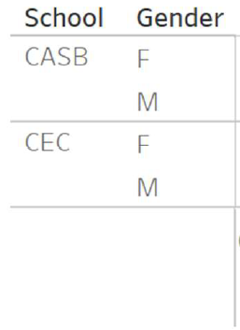
Tenure Policies
Tenure Policies
body of evidence for deciding tenure
whether I will achieve tenure
Consistency of messages about tenure
Notes:
1st click: female faculty in CASB seems to have a better clarity in tenure process than other groups
2nd click: male faculty in CASB seems to feel a better consistency of message about tenure than other groups.
3rd click: male faculty in CEC feel less consistency on tenure message

Slide 23
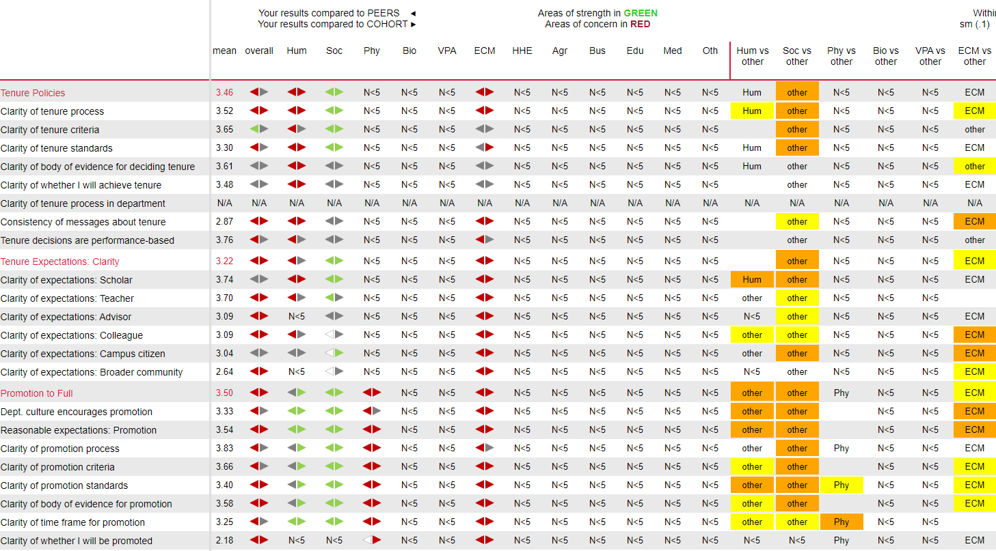
Discipline- Specific
: Peers
Cohort
Green: Area of strength
Red: Areas of concern
The discipline areas and departments alignment table is provided in Appendix
Notes:
1st click: Let’s take a look of disciplinary breakdown for additional insights.
2nd click: faculty in social science area seem to have a higher degree of clarity in terms of tenure policies, expectation, and promotion to full than our 5 peers and 110 cohort universities.
3rd click: faculty in ECM are in the opposite end compare to our 5 peers and 110 cohort universities.
4th click. compare to our 5 peers and 110 cohort universities, pre-tenured Humanity faculty are less clear on tenure process and expectation.
5th click: However, associate professors in humanity have a higher clarity on how to promote to full professor rank than 5 peers and 110 cohort universities,

Slide 24
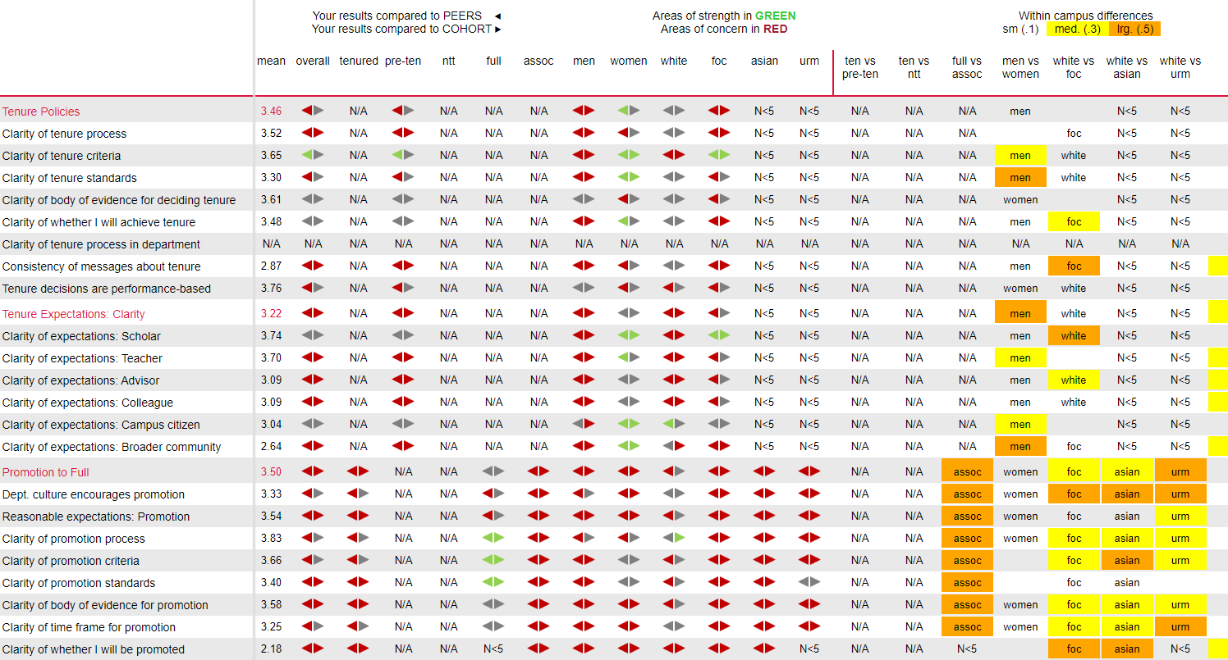
Demographic
Notes:
1st click: Among pre-tenure faculty, female faculty have a higher clarity in most tenure policies and expectations compare to our 5 peers and 110 cohort universities.
2nd click: However, male faculty are on the opposite and have a lower clarity in tenure policies and expectations compare to our 5 peers and 110 cohort universities.
3rd click: Among associate professor group
4th click: the clarity to promote to full are lower than our 5 peers and 110 cohort universities across different demographic groups.

Slide 25
Areas S&T performed below the selected peer group
2016
2020
Noticeable negative change
Tenure Expectation: Clarity
Leadership: Departmental
Cross-Silo Work & Mentorship
Nature of Work
Resource & Support
P&T
Leadership
Governance
Department
Teaching
Senior
Faculty
Trust
Research
Service
Mentoring
Divisional
Adaptability
Collaboration
Tenure Policies
Departmental
Productivity
Dept. Quality
Promotion to Full
Dept. Collegiality
Facilities & Work Resources
Dept. Engagement
Interdisciplinary Work
Appreciation &Recognition
Personal & Family Policies
Tenure Expectations: Clarity
Shared Sense of Purpose
Health & Retirement Benefits
Understanding the Issue at Hand
Notes:
1st click: Let’s take a closer look of clarity of department leadership
2nd click: this is where we were in 2016
3rd click: when we performed better than our 5 peers
4th click: unfortunately, we are now the worst performer compare to our 5 peers and most of our 110 cohort universities.

Slide 26
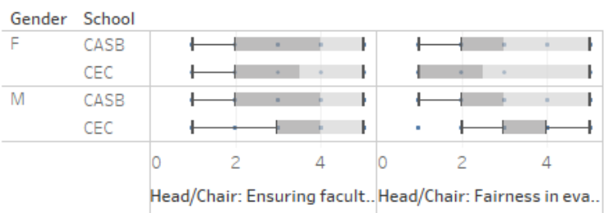
Department Leadership
Chair/Head
Pace of decision making
Stated priorities
Communication of priorities
Chair/Head
Ensuring faculty input
Fairness in evaluating work
Notes:
The department leadership seems to be an issue in both college for both male and female faculty. However,
1st click: female faculty in CEC seem to be more satisfied with the department chair’s pace of decision making
2nd click: male faculty in CEC are more satisfied with the department chair’s communication of priorities and fairness in evaluating one’s work
Note to Daniel: Sam, Wayne, or Bih-Ru can provide additional explanations on those box plots if needed.

Slide 27
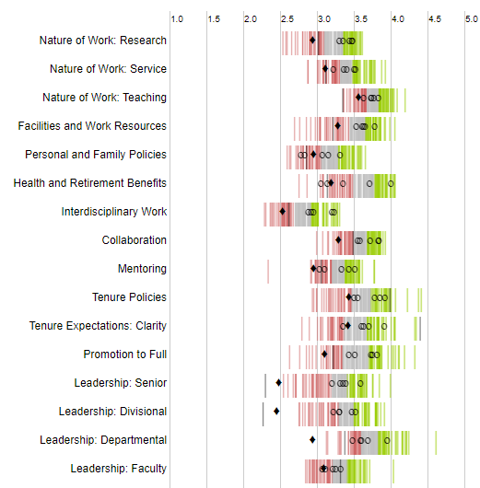
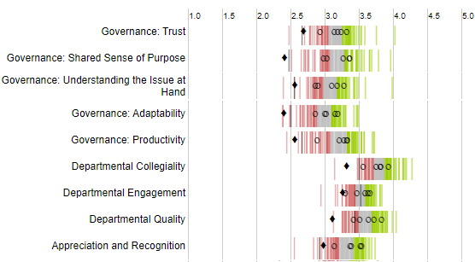
Faculty of Color (FOC) Group on Department Leadership
The lowest in our 5 peers and in all 110 similar universities
Notes:
1st click: From the initial investigation, the COACHE Committee also noticed that the faculty of color ranked the department leadership the lowest among our 5 peers and 110 cohort universities.
2nd click: Faculty of color at S&T have more negative feeling on the departmental collegiality, engagement, and quality than our 5 peers and 110 cohort universities.

Slide 28
Areas S&T performed below the selected peer group
Nature of Work
P&T
Leadership
Governance
Department
Teaching
Senior
Faculty
Trust
Research
Service
Mentoring
Divisional
Adaptability
Collaboration
Tenure Policies
Departmental
Productivity
Dept. Quality
Promotion to Full
Dept. Collegiality
Facilities & Work Resources
Tenure Expectations: Clarity
Dept. Engagement
Interdisciplinary Work
Appreciation &Recognition
Personal & Family Policies
Shared Sense of Purpose
Health & Retirement Benefits
Understanding the Issue at Hand
Notes:
Leadership at various levels remain problematics in 2020.

Slide 29
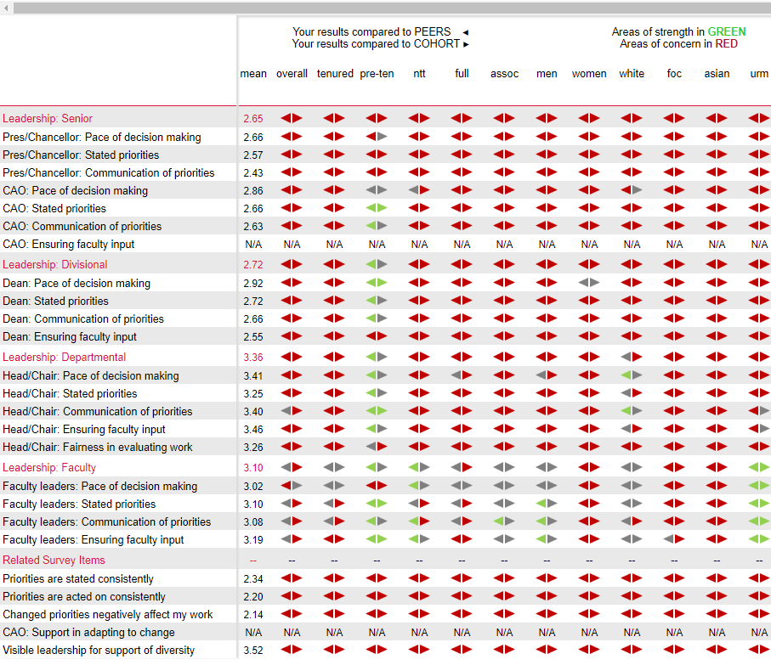
Leadership
Notes:
1st click: Although there are improvements, the leadership of different levels remain an issue across various demographic breakdowns.
2nd click: However, the leadership issue is less serious among the pre-tenure faculty group compare to our 5 peers and 110 cohort universities.
3rd click: it is note worthy that the under-represented minority faculty group ranks S&T’s faculty leadership higher than our 5 peers and 110 cohort universities.
4th click:
5th click:
6th click:
7th click:

Slide 30
Senior Leadership
Chancellor
Pace of decision making
Stated priorities
Communication of priorities
Provost
Pace of decision making
Stated priorities
Communication of priorities
Notes:
To take a closer look at the senior leadership in terms of pace of decision making, stated priorities, and communication of priorities.
1st click: For the Chancellor’s leadership, female faculty in CASB are more consistent in their concerns regarding Chancellor’s pace of decision making and communication of priorities.
2nd click: female faculty in CEC are consistently having negative views on the Chancellor’s leadership in all three areas while their male counter parts have both positive and negative views in those three areas.
3rd click: For the Provost’s leadership,
4th click CEC faculty, most male and female faculty in CEC have concerns in all three measured areas while CASB faculty are more diversified in their positive and negative views.

Slide 31
College Leadership
Notes:
As college differ noticeably in the leadership dimension, we examined the difference and discovered that
1st click: both male & female faculty in CASB are more positive with Dean’s pace of decision making.
2nd click: female faculty in CASB are more positive with Dean’s stated priorities
3rd click: more CEC faculty are concerned with Dean’s communication of priorities and Dean’s ensuring of faculty input.

Slide 32
Best & Worst Aspects
Best Aspects
Worst Aspects
Notes:
Faculty are asked to identify two best and two worst aspects from a list of common characteristics of the academic workplace working at your institution.
1st click: The top four overall best aspects are cost of living, quality of undergraduate students, quality of colleagues, and support of colleagues.
2nd click: The top four overall worst aspects are quality of leadership, compensation, geographic location, and quality of graduate students.

Slide 33
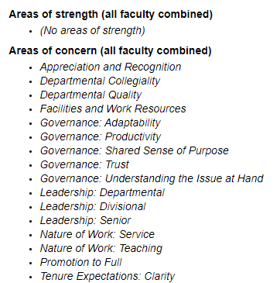
Overall: Strengths and Concerns
Also in 2016
Improved since 2016
New in 2020
Notes:
There is no identified areas of strength. There are 16 areas of concern identified.
1st click: 14 of those 16 areas are also identified as areas of concern in 2016.
2nd click: 12 of the 14 areas of concerns have improved since 2016.

Slide 34
Department as a Place to Work
Notes:
About 60% of faculty are satisfied working at their department compare to close to 70+% at our 5 peers and at 110 cohort universities.
1st click: about 43% faculty indicated that they would strongly recommend their department to candidates compare to about 54% at our 5 peers and at 110 cohort universities.
When compare to our 5 peers and the 110 cohort universities, S&T has twice more faculty who are dissatisfied and would not recommend their department

Slide 35
S&T As a Place to Work
Notes:
About 36% of faculty are satisfied working at S&T compare to close to 70% at our 5 peers and at 110 cohort universities.
1st click: about 40% faculty indicated that they will choose S&T again compare to about 70% at our 5 peers and at 110 cohort universities.
When compare to our 5 peers and the 110 cohort universities, S&T has 2.5 to 3 times more faculty who are dissatisfied and would not recommend S&T.

Slide 36
Overall: One Improvement Area
COACHE asks faculty to describe the one thing an institute can do to improve the workplace for faculty
COACHE analysts assigned all responses to one or more common theme
Quality of graduate students
Compensation
Geographic location
Quality of leadership

Slide 37
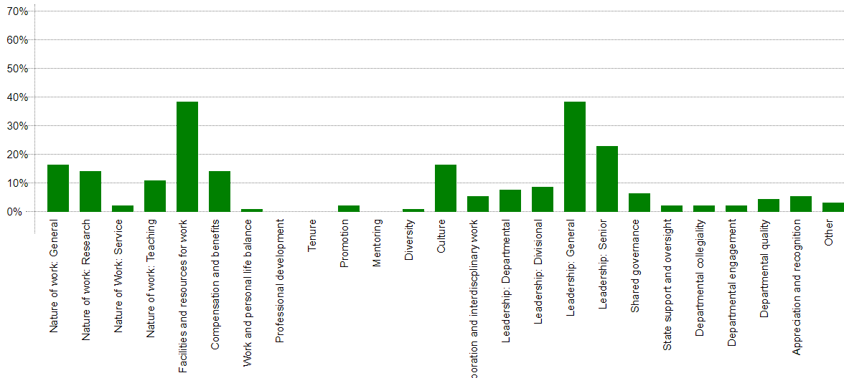
One Improvement Area: 2020
Leadership: General (both 2016 & 2020)
Quality of graduate students
Compensation
Geographic location
Quality of leadership
Notes:
Faculty were asked to identify one thing their institutions could do to improve the workplace for.
1st click: The facilities and resource for work and leadership in general are top two improvement areas identified.
2nd click: The leadership in general was also the top improvement area in 2016

Slide 38
Where to Go from Here?
COACHE Committee collects inputs and ideas from today’s open forum to form focus committees
Clarity of Tenure Expectation
Department Leadership
Senior Leadership
Divisional (College) Leadership
COACHE Focus Committee report findings and action items in November, 2020

Slide 39
Q & A
Your inputs
& Ideas
MATTERS!!
Notes:
Our COACHE Committee members will be taking notes from your inputs and ideas, so we can craft an actionable plans.

Slide 40
Appendix: Discipline Areas & Departments
Area | Department
Humanities | Arts, Languages & Philosophy
 | English & Tech Communication
Social Science | Economics
 | History & Political Science
 | Psychological Science
Physical Sciences | Chemistry
 | Physics
Biological Sciences | Biological Sciences
Business | Business & Information Tech
Education | Teacher Educ & Certification
Area | Department
"ECM" Eng,CS,Math,Stat | Chemical & Biochemical Engrg
 | Civil, Arch & Environ Engr
 | Computer Science
 | Electrical & Computer Engineer
 | Engineering Mgt & Sys Engr
 | Geosciences&Geological&Pet Eng
 | Materials Science & Eng
 | Mathematics & Statistics
 | Mechanical & Aerospace Engin
 | Mining & Nuclear Engr

